Slide 1


CAPSTONE PROJECT
Blinkit Grocery Sales Data Analysis
Presented By
Student Name: CHIRUMAMILLA GAMANA
College Name: KL UNIVERSITY
Department: ECE
Email ID: 2320040075@klh.edu.in

Slide 2
OUTLINE:
Problem Statement
Proposed System/Solution
System Development Approach
Algorithm & Deployment
Result (Output Image)
Conclusion
Future Scope
References

Slide 3
Problem Statement:
Urban quick-commerce platforms like Blinkit face challenges in managing grocery sales efficiently.
Businesses often lack insights into customer purchasing patterns and outlet performance.
Without data-driven analysis, decision-making relies on assumptions, leading to:
Overstock or stockouts of grocery items
Inefficient allocation of resources across outlets
Loss of potential revenue
Decreased customer satisfaction
There is a need to analyze sales data, customer ratings, and outlet details to identify trends and optimize operations.
Goal: Enable stakeholders to make strategic decisions backed by actionable insights.

Slide 4
Proposed Solution:
Use historical Blinkit sales data to understand sales patterns and customer preferences.
Analyze outlet performance based on type, size, location, and age.
Integrate multiple tools for end-to-end analysis:
SQL – Data extraction, transformation, aggregation
Python – Data cleaning, EDA, visualizations
Excel – Quick KPI verification
Power BI – Interactive dashboards for business insights
Key outcomes:
Identify high- and low-performing products and outlets
Suggest strategies to improve revenue and efficiency
Provide a visual, interactive, and actionable dashboard for stakeholders

Slide 5
System Approach:
Step 1: Data Collection
Gather sales, outlet, and customer rating data
Include product details: item type, fat content, and revenue generated
Step 2: Data Preprocessing
Clean missing values, remove duplicates
Feature engineering for metrics like avg. sales, avg. rating
Step 3: Analysis & Visualization
Python: Grouped metrics, trends, and correlation analysis
Power BI: Interactive charts, matrices, KPI cards
Step 4: Dashboard Deployment
Real-time insights for stakeholders
Drill-down, dynamic filtering, and geo-based analysis

Slide 6
Algorithm & Deployment:
SQL: Extract and aggregate sales, ratings, and outlet data
Python (Pandas, Matplotlib, Seaborn):
Data cleaning and preprocessing
Exploratory Data Analysis (EDA)
Trend visualization and correlation study
Power BI:
Interactive dashboard with charts (donut, bar, stacked column, funnel map, KPI cards)
Dynamic filters and drill-downs for stakeholder interaction
Workflow Summary:
Data extraction → 2. Data cleaning → 3. EDA → 4. KPI calculation → 5. Dashboard visualization

Slide 7
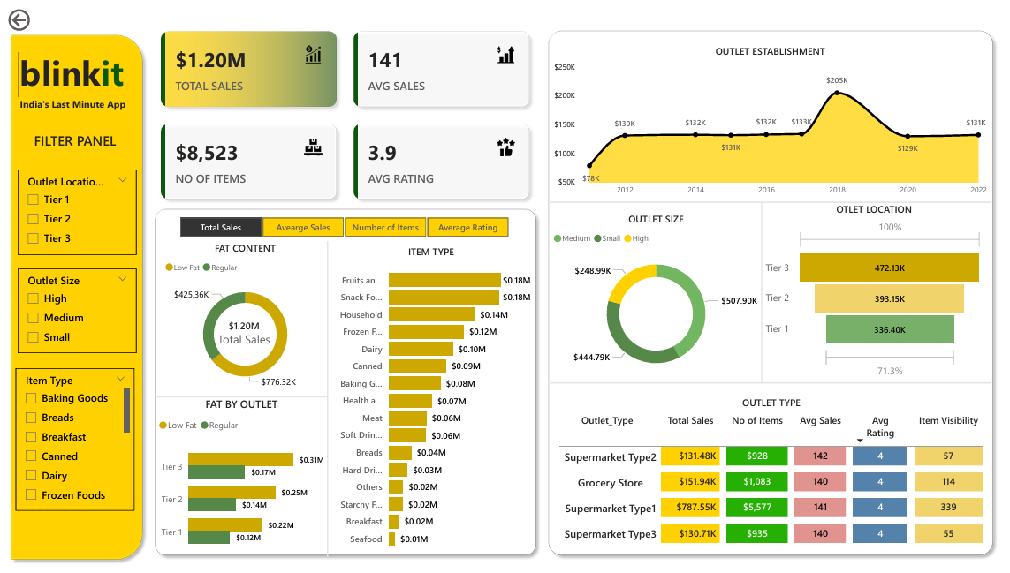
Result:
Sales Analysis:
Top-performing product categories contributing most to revenue
Revenue distribution by fat content, item type, outlet type, and location
Outlet Performance:
Larger and older outlets in premium locations generated higher revenue
Customer Behavior:
High ratings correlated with best-selling products and outlets
Trends in purchases by time, location, and category
drill-down analysis

Slide 8
Conclusion:
The project demonstrates the power of data-driven decision making in retail grocery.
Stakeholders can identify trends, optimize inventory, and improve outlet performance.
Integration of Python, SQL, Excel, and Power BI provides a full business intelligence workflow.
The interactive dashboard allows stakeholders to filter, drill-down, and view insights quickly.
Outcome: Improved revenue potential, efficient operations, and better customer satisfaction.

Slide 9
Future scope:
Integrate real-time sales data for live monitoring
Add predictive analytics for inventory demand forecasting
Include marketing analytics: promotions, discounts, campaigns
Expand analysis to multiple cities or regions for a broader business strategy
Incorporate sentiment analysis from customer feedback for deeper insights

Slide 10
References:
Demand Prediction on Bike Sharing Data Using Regression Analysis – A study comparing multiple statistical models for predicting bike demand with weather and time variables, measuring accuracy with RMSE and R‑Squared.
Bike‑Sharing Demand Forecasting Using Machine Learning – Describes a practical ML pipeline for station‑level demand forecasting and deployment in a real system, highlighting the value of ML in operational predictions.
GitHub Link: https://github.com/gamana29/Blinkit_Data_Analysis.git

Slide 11
Thank You

